Slide 1
They almost got me
A Phishing awareness seminar
Archibald Azure

Slide 2
The art of digital deception
What is phishing?
Phishing simply refers to when attackers trick you into giving away your personal or sensitive information by pretending to be someone you trust—like your bank, employer, or a popular website.
In Phishing, attackers attempt to trick individuals into revealing sensitive information, such as usernames, passwords, credit card numbers, or other personal data, or to execute actions (like clicking a malicious link or opening an infected attachment).
The attacker achieves this by masquerading as a trustworthy entity in an electronic communication.

Slide 3
Why you should care
It Can Happen to Anyone
Visual: Real-life headlines
Between 2013 and 2015, Facebook and Google fell victim to a fake invoice scam, losing over $100 million. In the scam, Evaldas Rimasauskas, a Lithuanian hacker, set up a fake company that posed as Quanta Computer, a Taiwan-based computer manufacturer that works with Facebook and Google. The assailant further opened bank accounts for money laundering in several countries, including Cyprus and Latvia, under the same name as the fake company. Evaldas proceeded to send invoices to employees at Facebook and Google, leading them to wire him the requested funds

Slide 4
Why you should care
It Can Happen to Anyone
The Cyber Security Authority (CSA) has raised an alarm after cyber fraud losses in Ghana surged to GH₵4.4 million in the first quarter of 2025. This is a significant increase from GH₵2.4 million in the same period in 2024.

Slide 5
You don’t have to be famous or rich to be targeted. If you use email, text messages, or the internet — you’re a potential target.

Slide 6
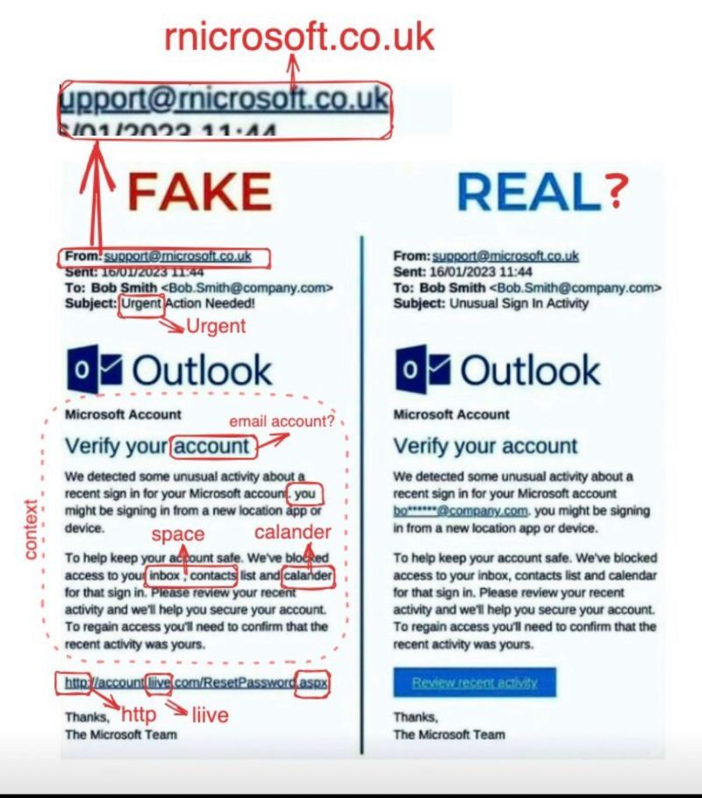
How to Spot a Phishing Email
Side-by-side of a real email vs. phishing email.
Strange sender address
Poor grammar or urgency
Suspicious links (hover over to preview URL)
Attachments you weren’t expecting

Slide 7
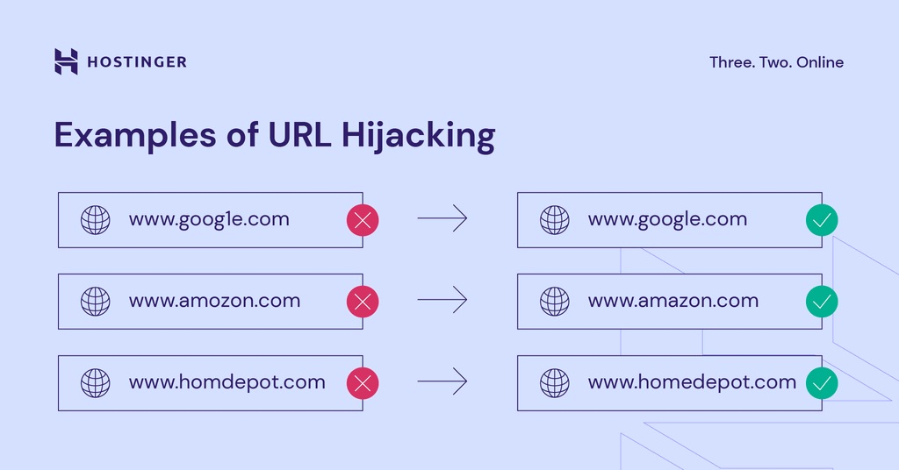
Fake Websites
Don’t Get Fooled by Lookalikes
Visual: Amazon.com vs. Amaz0n-payments.net
Tips
Check the URL (padlock, spelling errors)
Don’t click links — type web addresses yourself
Use bookmarks for important sites

Slide 8
The Human Side of Hacking
Message:
"Phishers often play with emotions: fear, urgency, curiosity, or authority.“
Real-World Examples:
“Your account will be deleted in 24 hours”
“Congrats! You’ve won a gift card!”
“CEO requesting urgent payment”

Slide 9
Simple Habits = Strong Defense
Checklist Format: ✅ Think before you click ✅ Don’t download unexpected attachments ✅ Use two-factor authentication (2FA) ✅ Report suspicious emails to IT/security ✅ Keep software and antivirus up to date

Slide 10
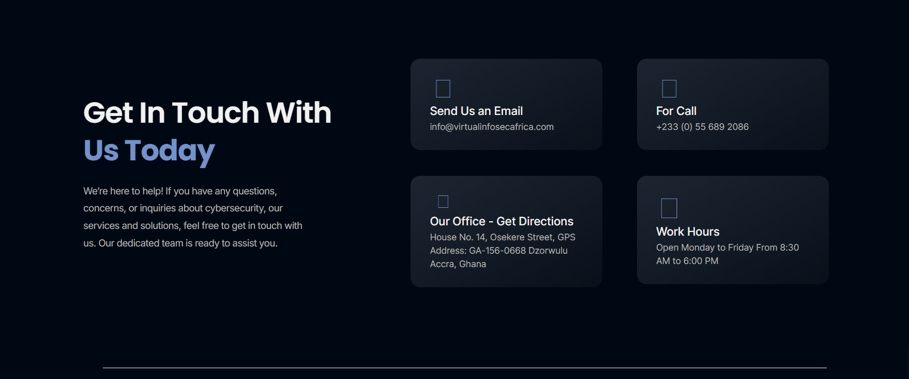
Stay Sharp, Stay Safe

Slide 11
Thank You

